Slide 1
How to use Geometric Calibration of Micro-Lens-Based Light Field Cameras using Line Features
Yunsu Bok, Hae-Gon Jeon and In So Kweon
Robotics and Computer Vison Lab., KAIST
IEEE Transactions on Pattern Analysis and Machine Intelligence, Accepted

Slide 2
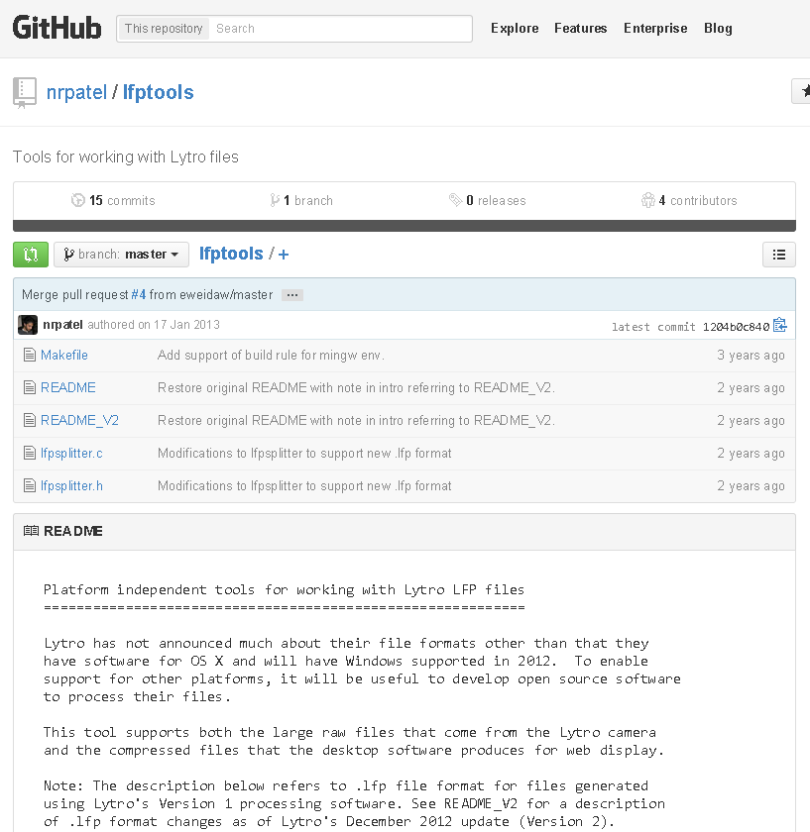
Step 0 : LFP → raw (Lytro)
We use lfpsplitter to get raw image from the lfp file.
Download : https://github.com/nrpatel/lfptools
raw → png
Read 3280x3280 12-bit values from a raw file.
Then apply ‘demosaic’ algorithm in MATLAB
(sensor alignment: bggr)

Slide 3
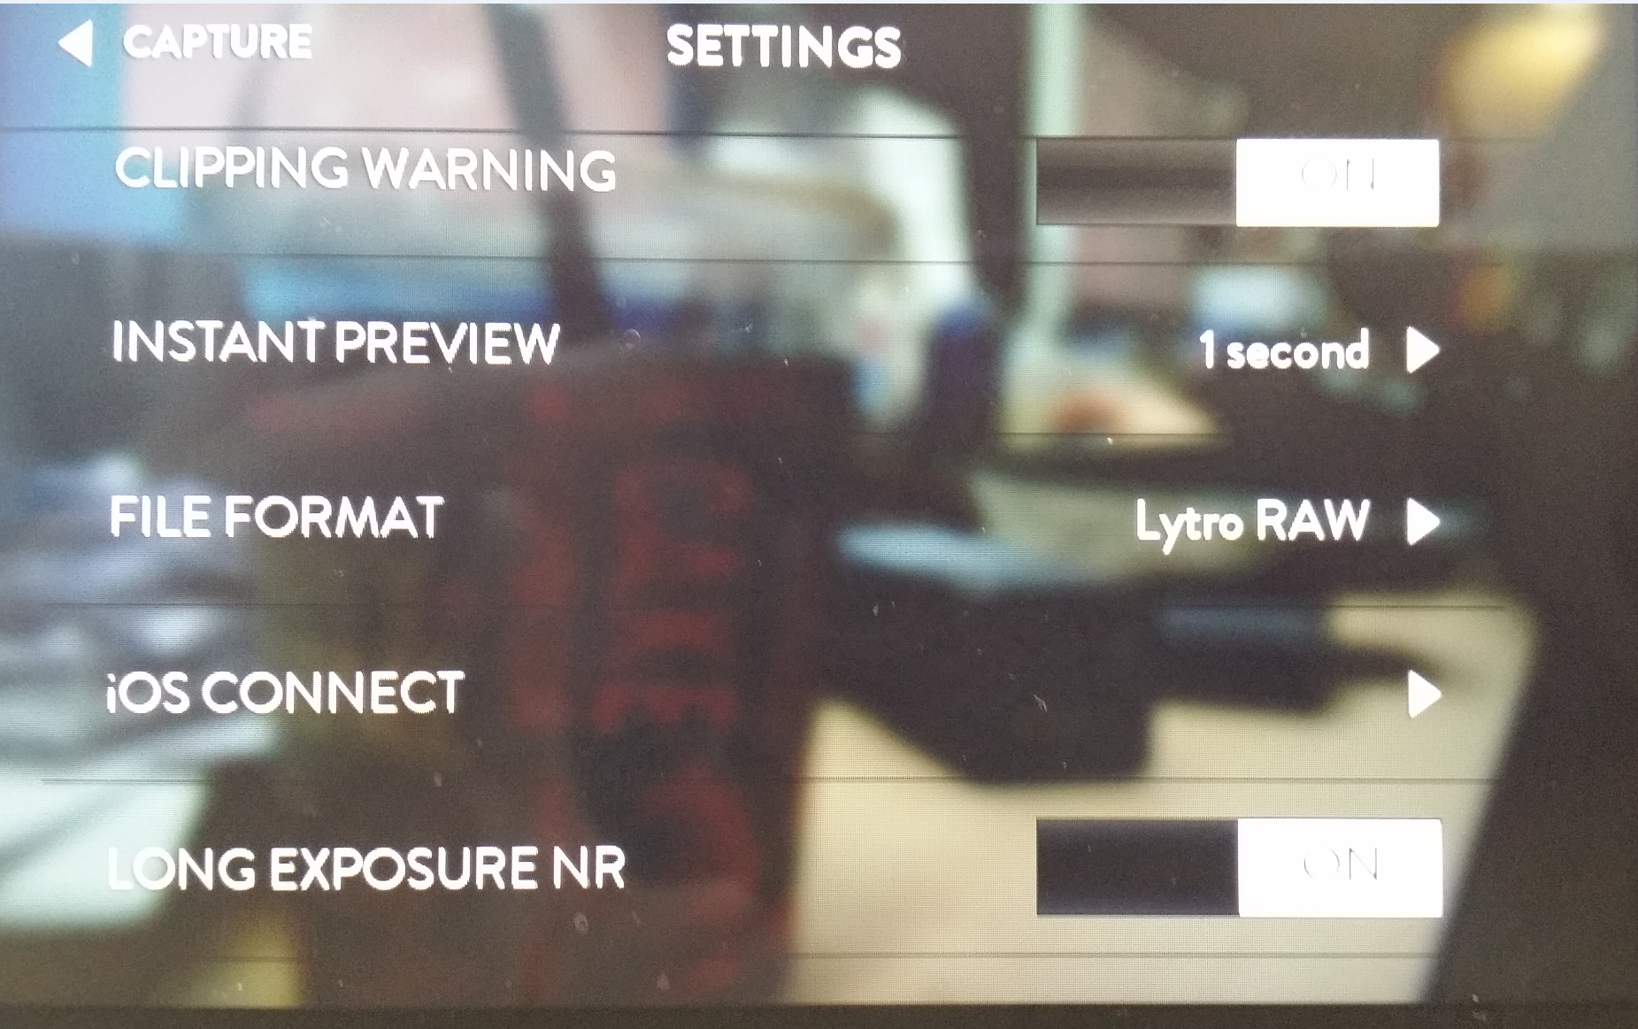
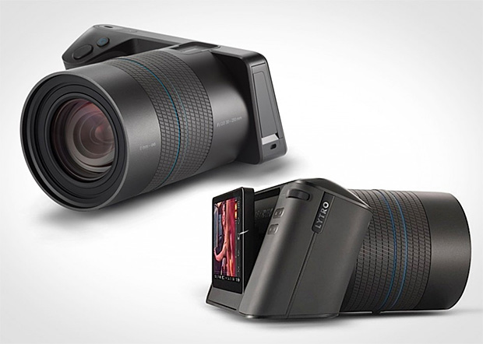
Step 0 : LFP → png (Lytro Illum)
We use the open source decoder “illum_full” made by Michael Tao,
a Ph.D student of UC Berkeley.
Source code available at : http://cseweb.ucsd.edu/~ravir/illum_full.zip
Set file format to Lytro RAW

Slide 4
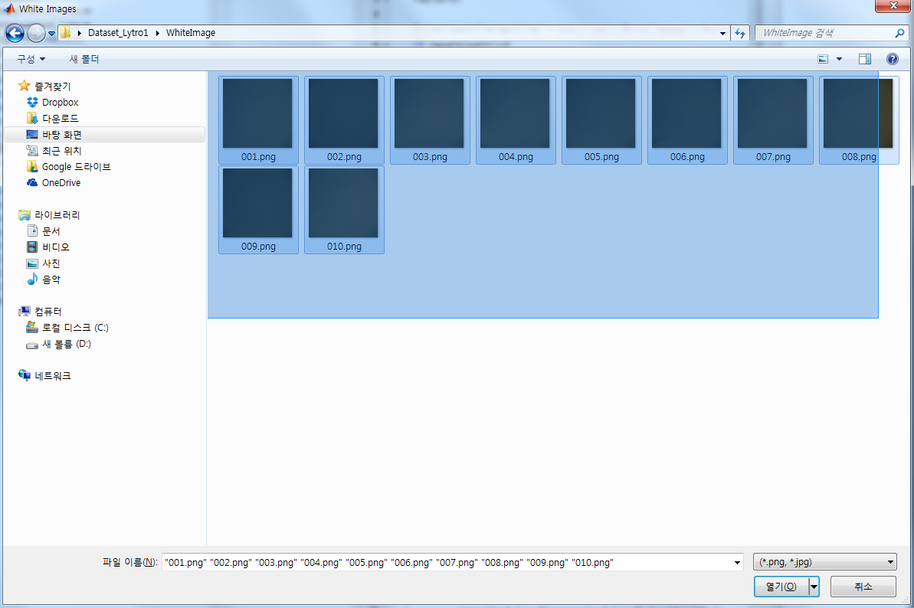
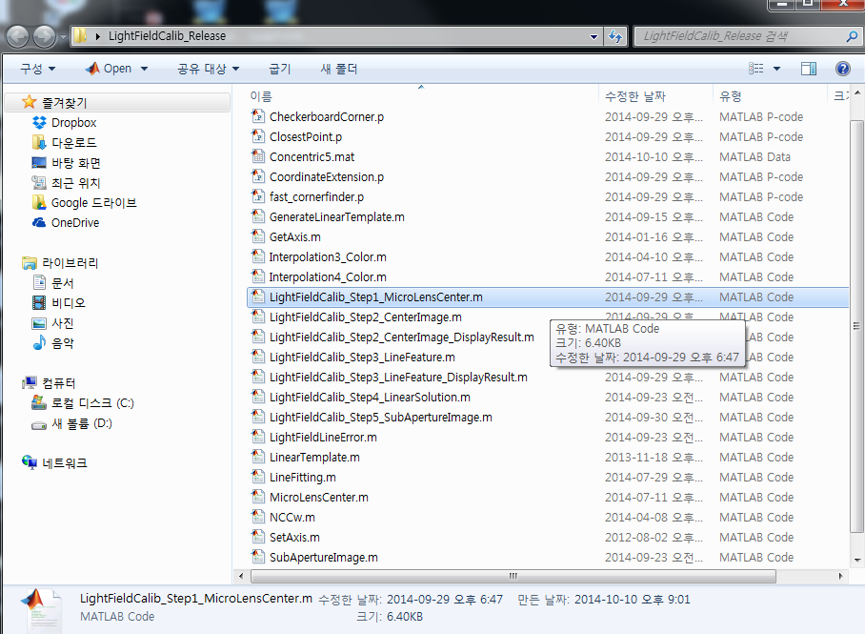
Step 1
Execute LightFieldCalib_Step1_MicroLensCenter.m
Drag and open White images

Slide 5
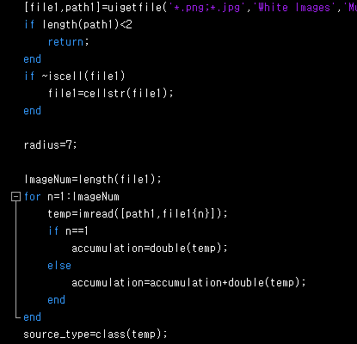
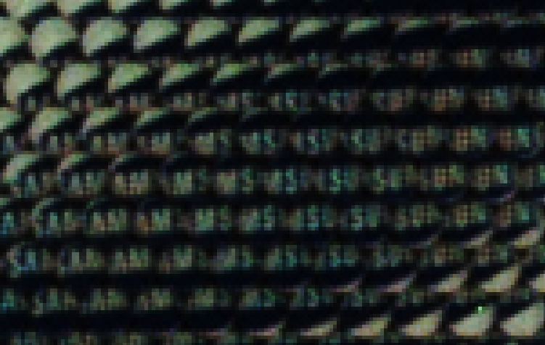
Step 1
Set radius to 5 for a Lytro camera
Set radius to 7 for a Lytro Illum camera
Microlens radius is 7 pixels

Slide 6

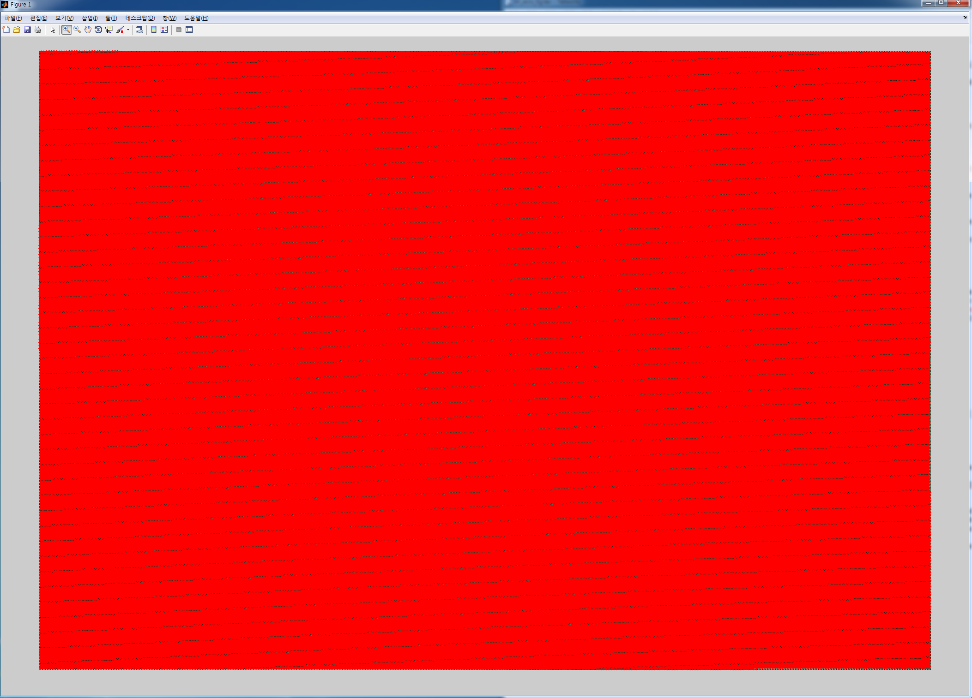
Step 1
Red dots are centers of microlens array.

Slide 7
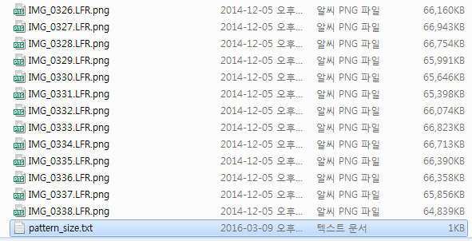
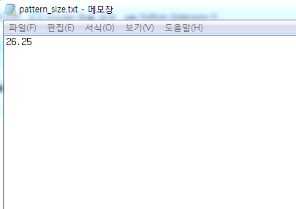
Step 2
Make pattern_size.txt file in image folder, and then input the size of pattern (unit: mm)

Slide 8
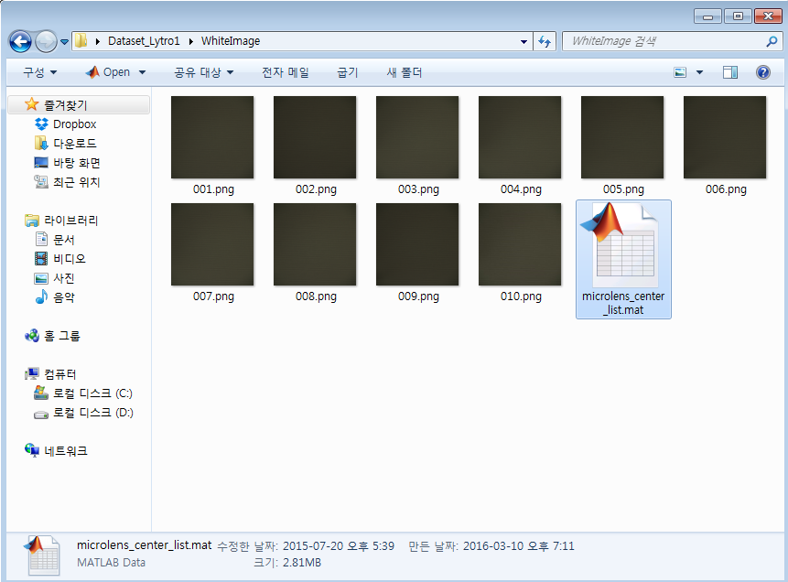
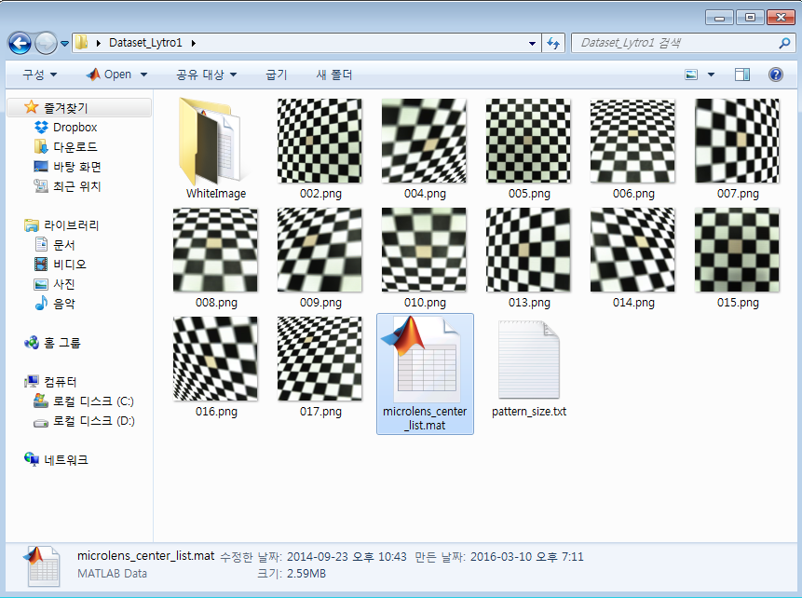
Step 2
Move Microlens_center_list.mat in white images folder to pattern images folder

Slide 9
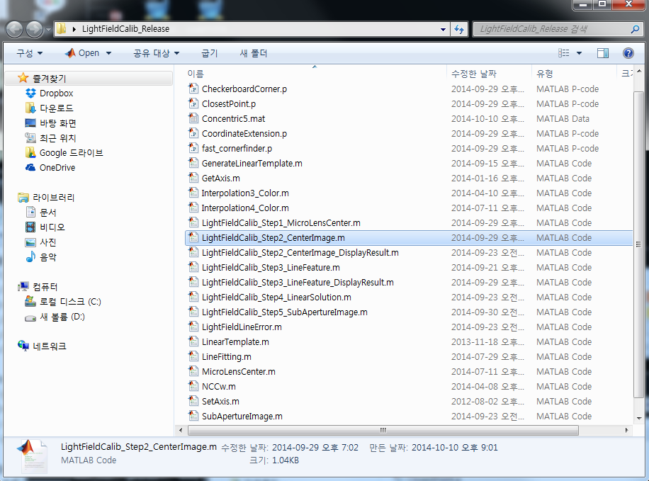
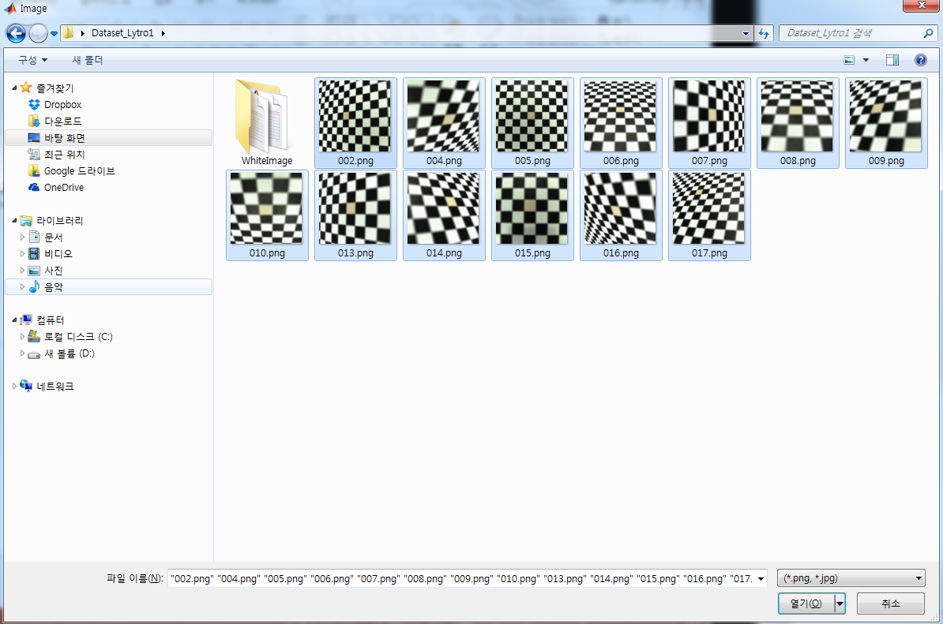
Step 2
Execute LightFieldCalib_Step2_CenterImage.m
Drag and open Pattern images

Slide 10
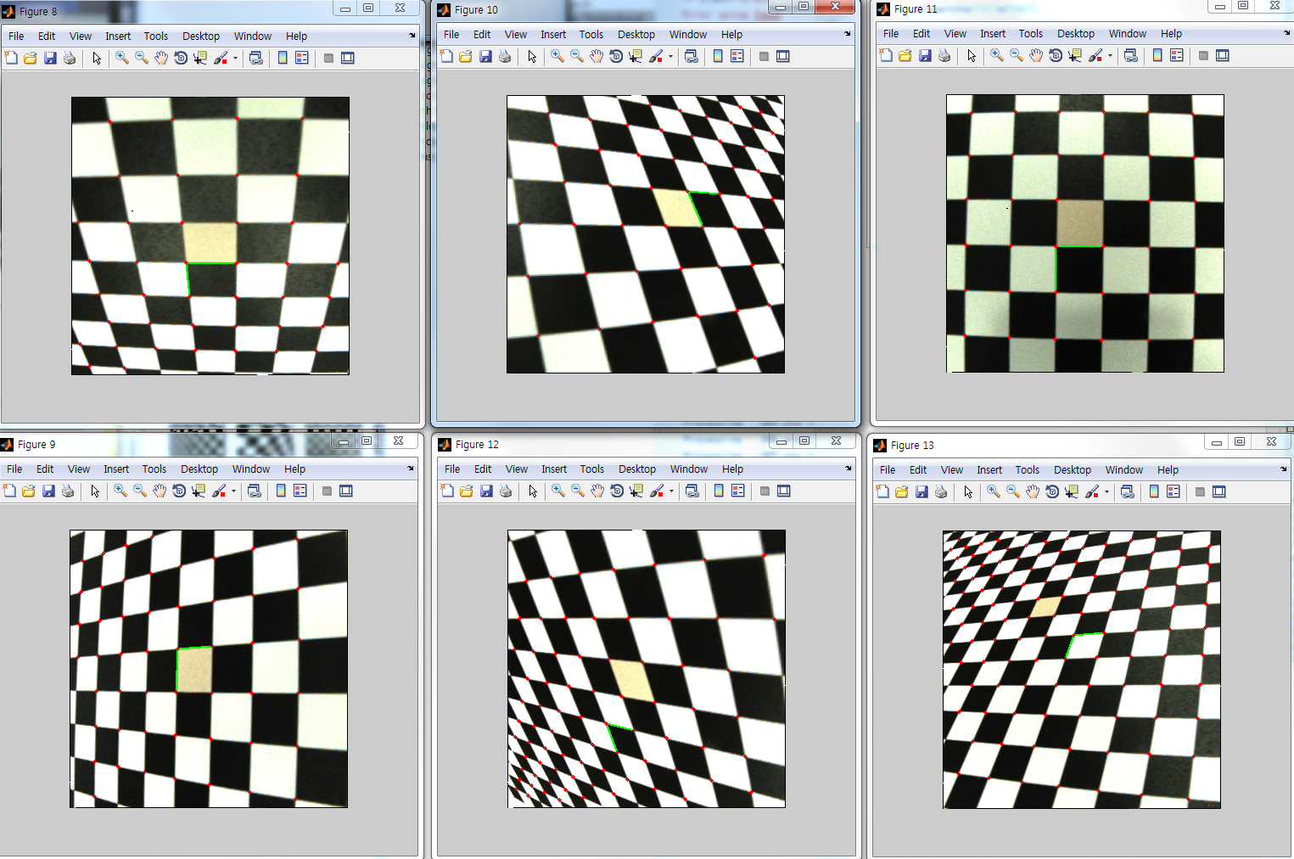
Step 2

Slide 11
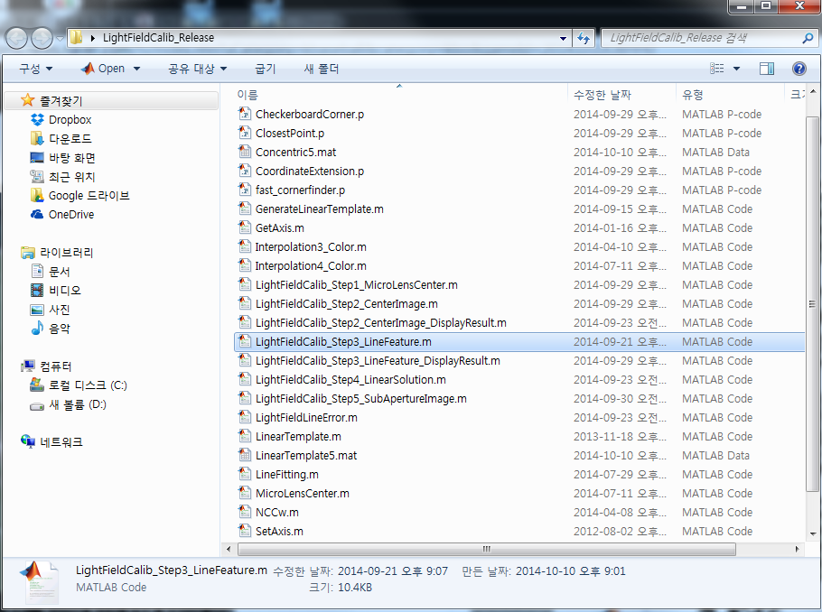
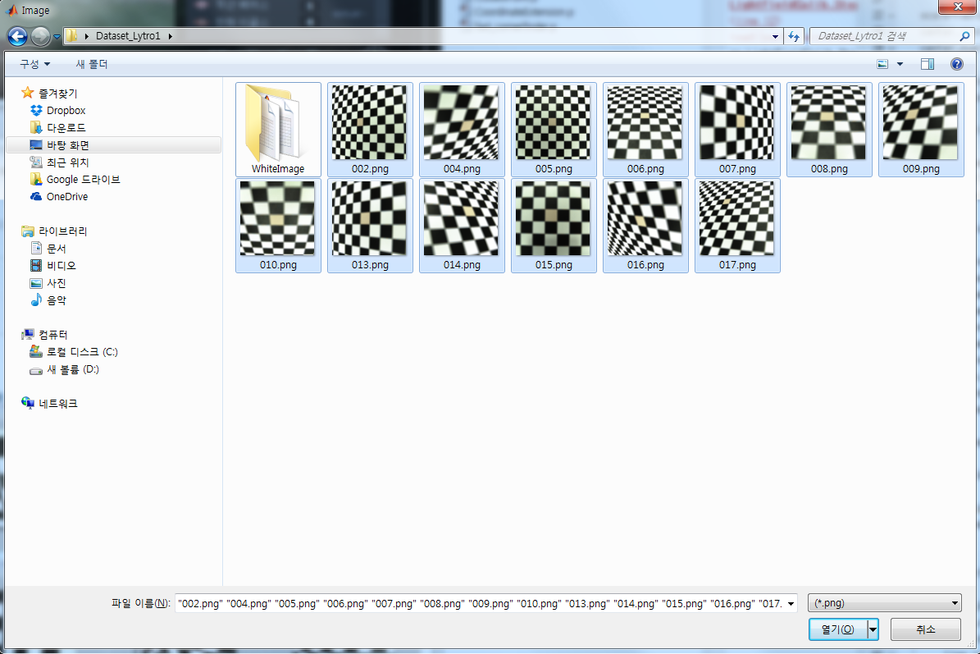
Step 3
Execute
LightFieldCalib_Step3_LineFeature
Drag and open Pattern images again

Slide 12
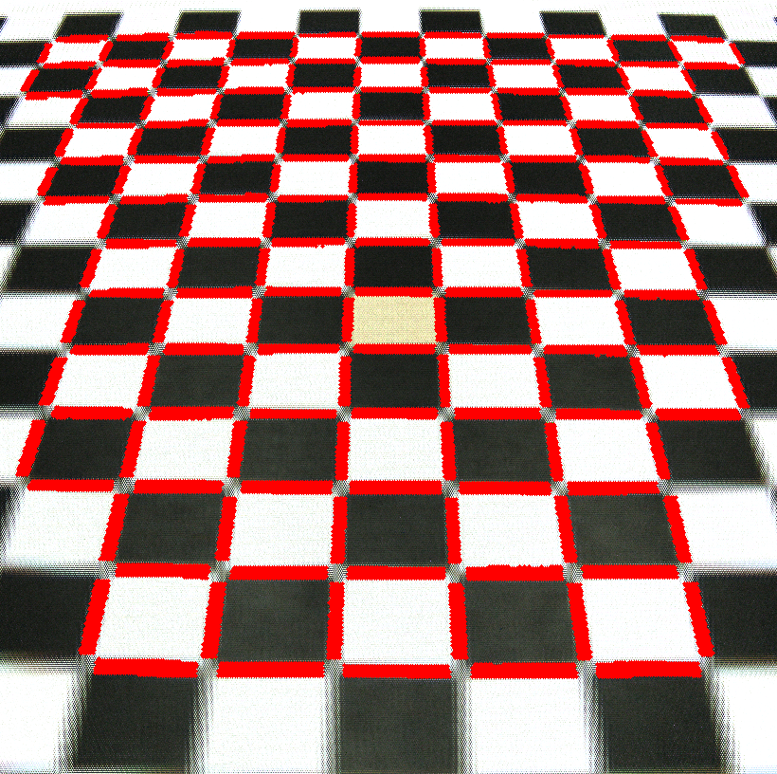
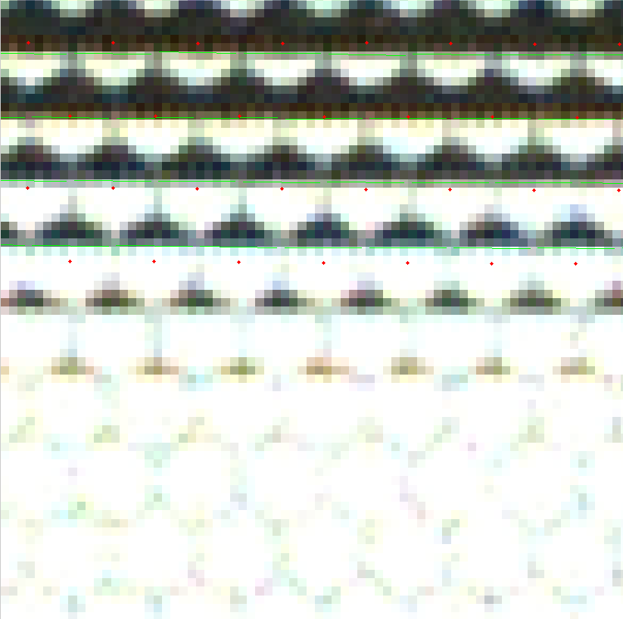
Step 3

Slide 13
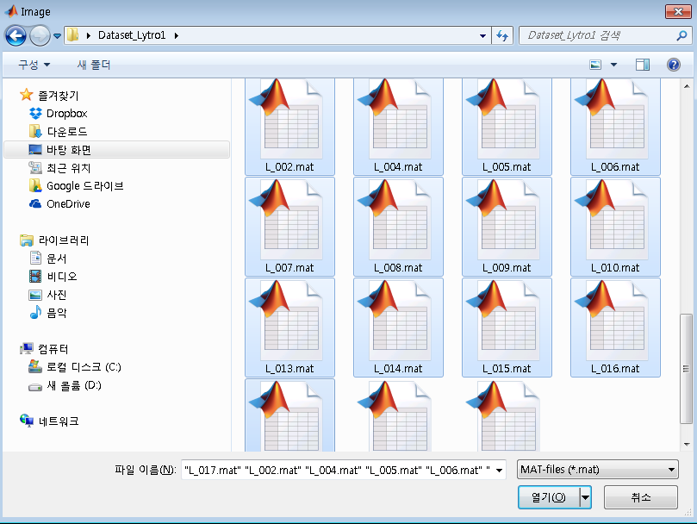
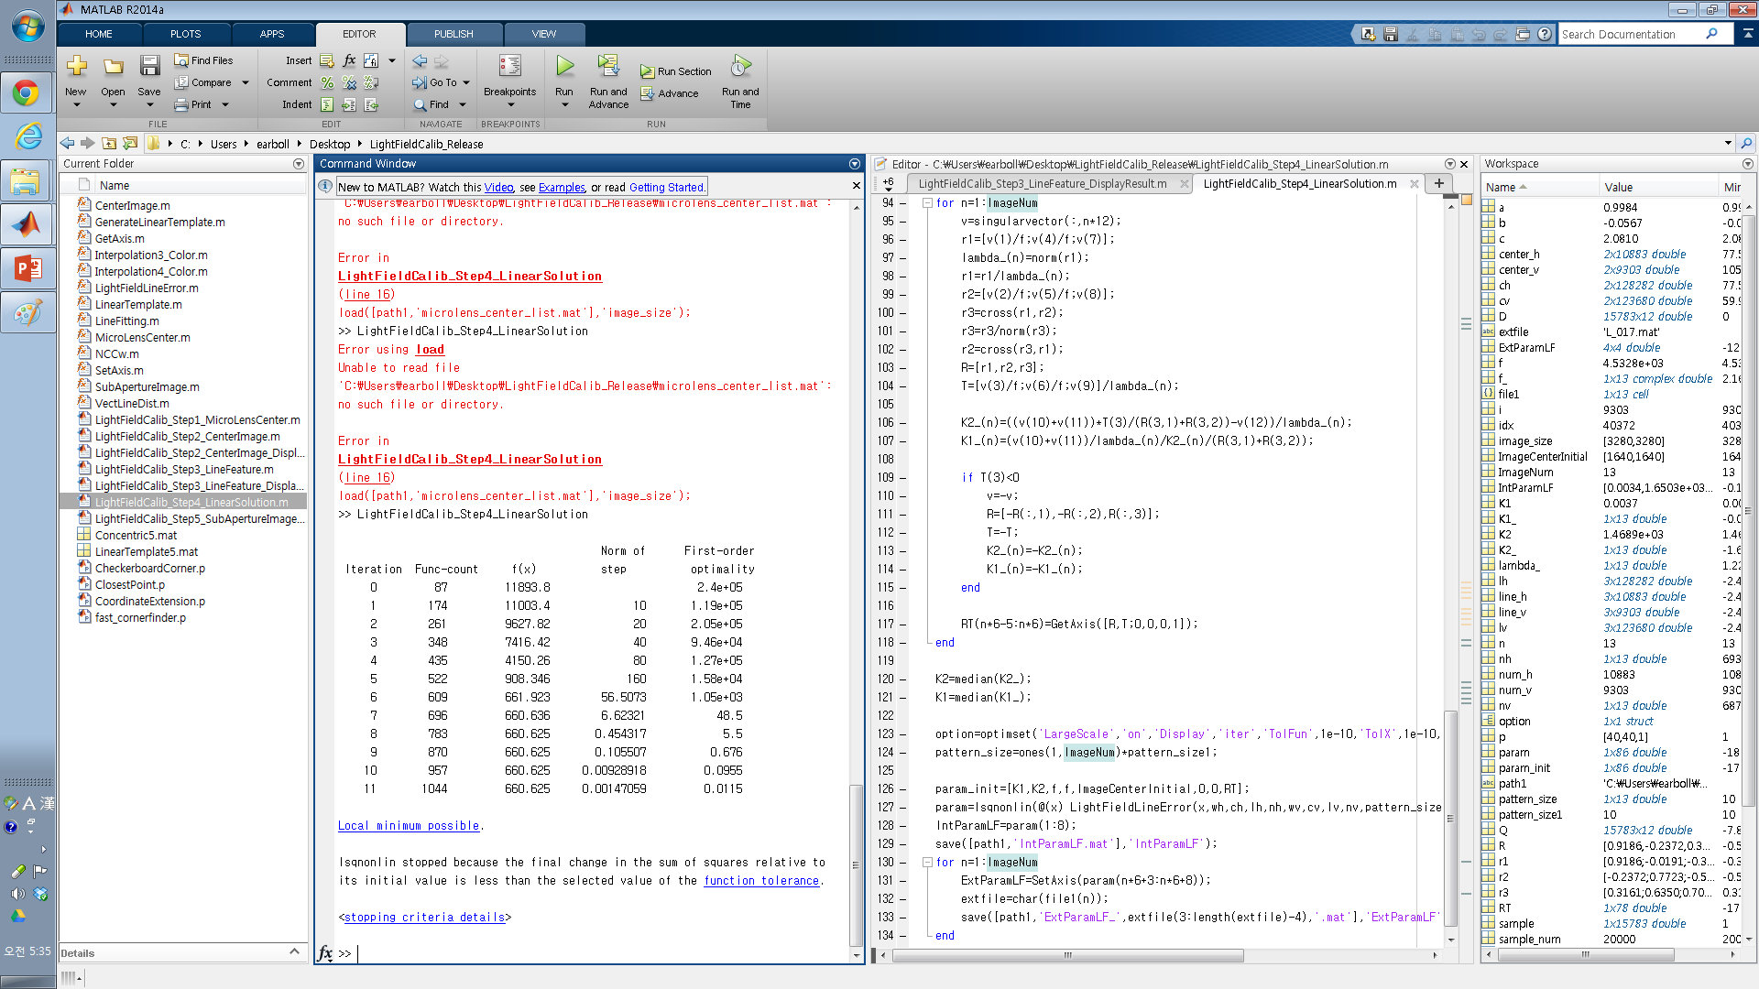
Step 4
Execute LightFieldCalib_Step4_LinearSolution.m
Drag and open Lxxx.mat files

Slide 14
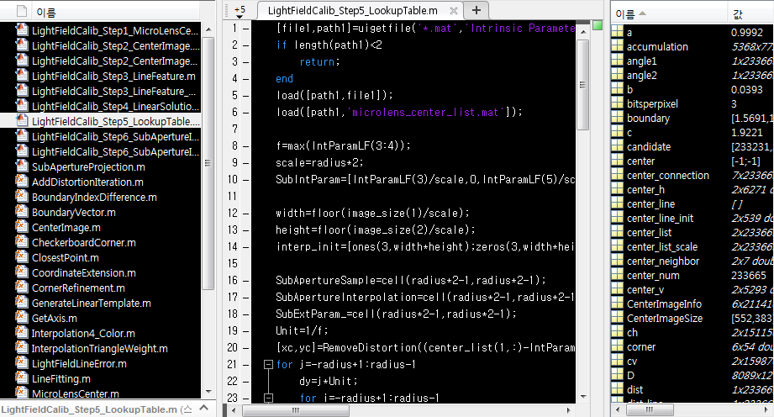
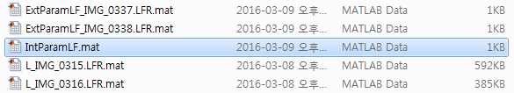
Step 5 : Look-up table
Execute LightFieldCalib_Step5_LookupTable.m
open IntParamLF.mat files

Slide 15
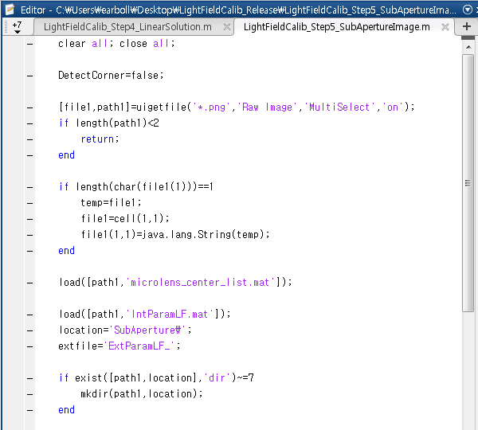
Step 6 : Sub-aperture image
If you want to detect corners of pattern images in sub-aperture image, DetectCorner =true
Otherwise, DetectCorner =false
Execute LightFieldCalib_Step6_SubApertureImage.m

Slide 16
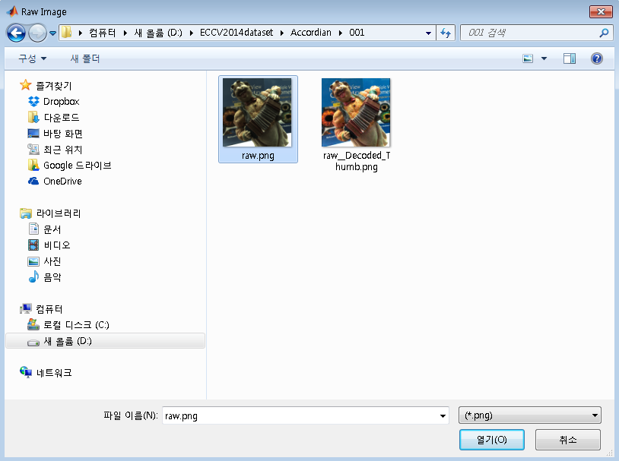
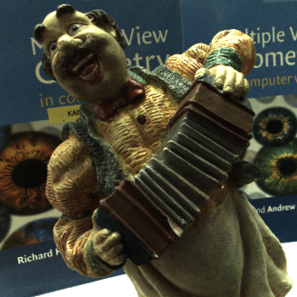
Step 6 : Sub-aperture image

Slide 17
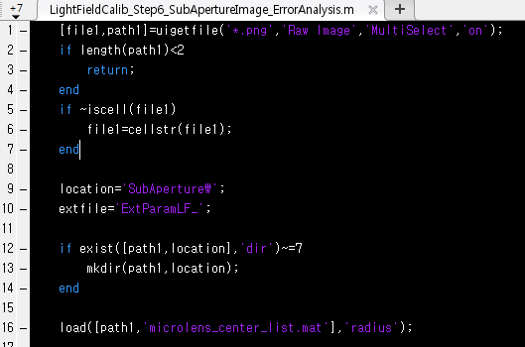
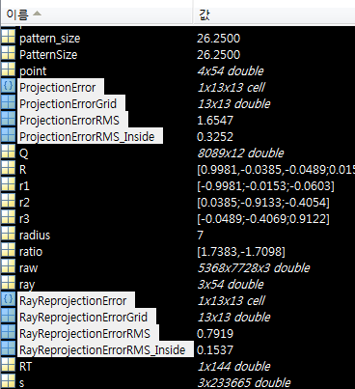
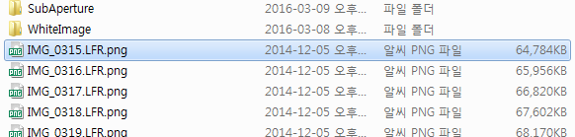
Step 6 : Sub-aperture image (Error Measure)
If you want to calculate projection Error and Ray reprojection error on checker board images, execute LightFieldCalib_Step6_SubApertureImage_ErrorAnalysis.m with lenslet images that you generate sub-aperture images. Please refer our TPAMI paper.

Slide 18
Question
Please contact Ph.D Yunsu Bok
E-mail : ysbok@rcv.kaist.ac.kr

